Slide 1

GEE Crime
&
Security
Notes:
Notes:

Slide 2
Gee Situation
Agenda
1.Overview crime situation
2. On security equipment
3. Security companies criteria's.
4. Property at Corner Longview and Foothill
5. Police reports

Slide 3
Overview crime situation
In the last few years GEE have had a few crimes
In common:
  They new how houses security works
  Breaking class doors and windows
  Not to open any doors or windows
  Climb through broken door or window glasses
  No night vision cameras or no cameras in right places

Slide 4
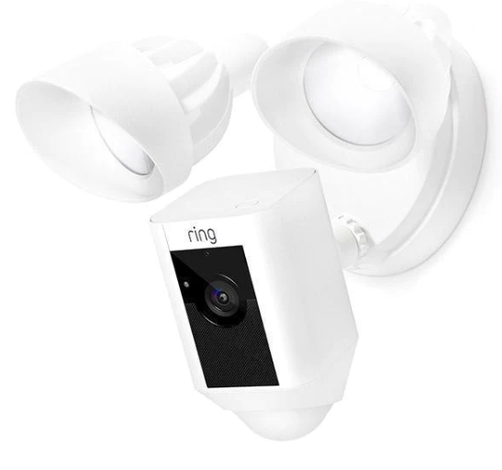
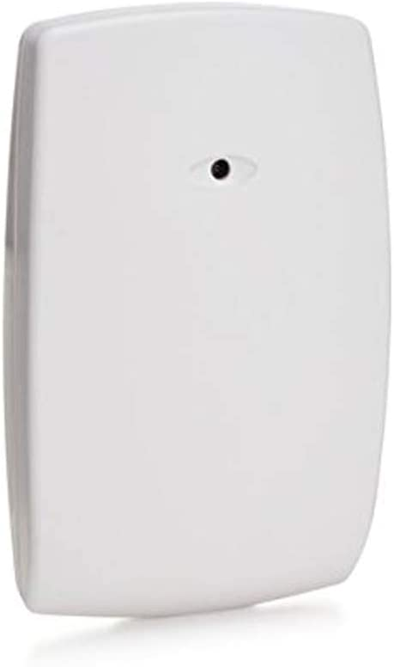
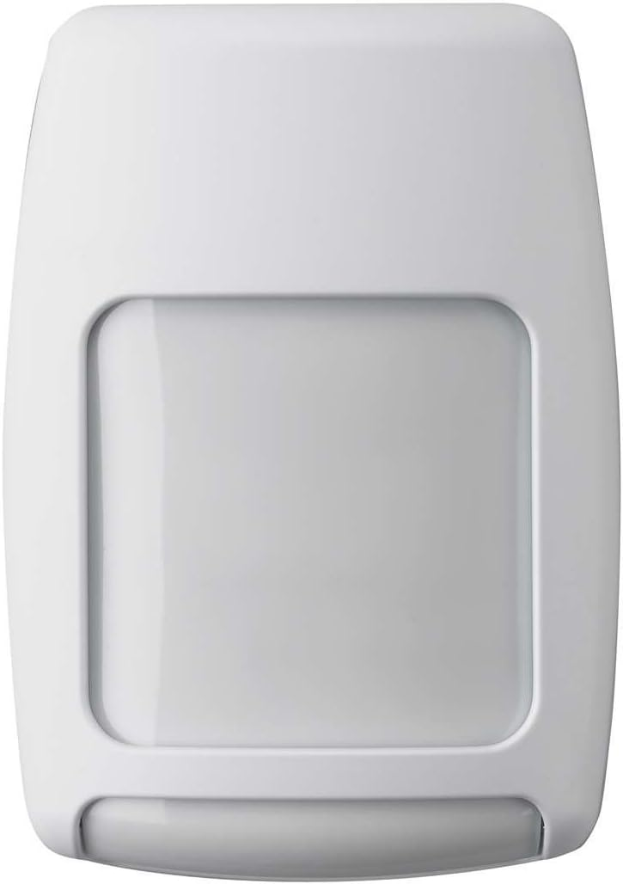
On security equipment
Equipment | Description | Samples
Cameras with flood lights | Motion sensor Web access Video with lights. Night vision | Ring or others
Glass sensors | One unit covers 30 Sq feet In each room with outside access Wireless to security system | Honeywell
Motion Sensors | One unit covers 30 Sq feet. In each room with outside access Wireless to security system | Honeywell

Slide 5
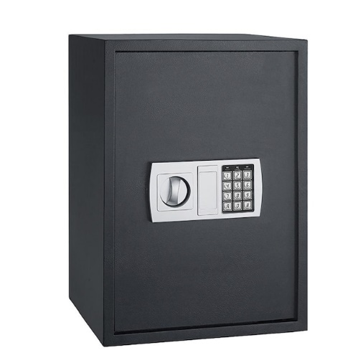
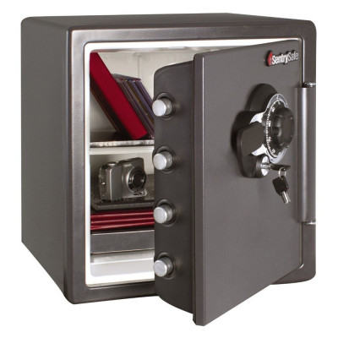
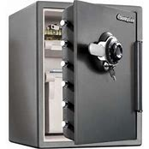
On security equipment
Equipment | Description
Safes | Bolted down Lockable closet Fire proof I prefer pad lock Check door thickness, cheap safes easy to break
Pad lock
Small
Large
https://securitysafeusa.com/burglary-and-fire?_vsrefdom=p.4633&msclkid=6f1ca6c7bd1417dcedcbc272263ce339&utm_source=bing&utm_medium=cpc&utm_campaign=330354%20%7C%20Security%20Safe%20GT&utm_term=best%20fireproof%20safes%20for%20home&utm_content=Fire%20B

Slide 6
Security companies
Criteria's
Wireless remote access
Who to call list in case of break-in
Immediately notifications via call to you
Modifiable to change order. I.E. on vacation, police first
Not home notify neighbors
Fast response time

Slide 7
Property at Corner Longview and Foothill
  Broke fence and Fence
  Used for walk-in crimes
  Both the city and I have tried to locate owner./ No success. City address of owner not valid
  My letter returned to sender
  Police report by Sargent Skages

Slide 8
Questions
Notes:
Notes:

